Slide 1
PHASE 3 PROJECT

Slide 2
Syriatel Customer Churn Classification Project

Slide 3
BUSINESS UNDERSTANDING
Syriatel's major challenge is losing customers leading to revenue loss, negative brand perception and increased acquisition costs. It aims at reducing customer churn .
The management would like to understand the factors that drive churn and create a model that predict it accurately hence helping Syriatel take targeted actions to retain valuable customers.

Slide 4
BUSINESS OBJECTIVES
Identify the key factors driving customer churn.
Develop a predictive model to classify customers at risk of leaving.
Enable Syriatel to take proactive actions to improve customer retention.
Enhance customer satisfaction and business sustainability.

Slide 5
DATA PREPARATION
Data cleaning
Data Analysis (Univariate Analysis , Bivariate Analysis and Multivariate Analysis)Handled missing values and removed duplicate records.
Standardized numerical features using standard scaler.
Encoding categorical variables using Label Encoding.
Splitting the dataset into training (80%) and testing (20%) sets

Slide 6
MODELING AND EVALUATION

Slide 7
The dataset was analyzing presents a binary classification challenge aimed at predicting churn, i.e., whether a customer will leave or not.
My approach involves utilizing a basic logistic regression model, with evaluation based on the recall score. Success criteria are set at achieving a recall score of 75% or higher. I employed the algorithms below;
Logistic Regression
Decision Tree
Random Forest

Slide 8
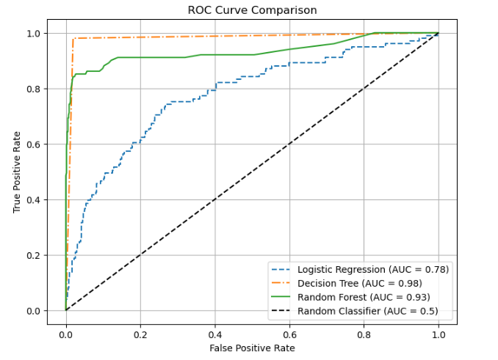
Decision Tree (AUC = 0.98):
Best at distinguishing churners but may be overfitting.
Random Forest (AUC = 0.93):
Strong performance with better generalization.
Logistic Regression (AUC = 0.78):
Struggles with complex patterns in the data.

Slide 9
CONCLUSION

Slide 10
Focus on Recall: Prioritized identifying high-risk churners to reduce misclassification.
Best Model: Random Forest outperformed others, offering strong accuracy and stability.

Slide 11
Key Churn Factors:
High Total Day Charge
Frequent Customer Service Calls
Number of Voicemail Messages
Next Steps:
Explore additional customer behaviour patterns.
Continuously refine the model for better accuracy.
Implement targeted retention strategies.

Slide 12
RECOMMENDATIONS

Slide 13
Offer discounts or loyalty programs for high-risk customers.
Improve customer support to reduce dissatisfaction.
Encourage long-term contracts by offering incentives.
Monitor high-churn segments and take proactive retention measures.

Slide 14
THANK YOU

